Slide 1
Acute Liver Failure Study Group: A Success Story
William M. Lee, MD
Meredith Mosle Chair in Liver Disease
Division of Digestive and Liver Diseases
UT Southwestern Medical Center at Dallas
GI Grand Rounds
UTSW, September 4, 2019

Slide 2
Disclosures
Research Support: Merck, Gilead, Conatus, Intercept, NovoNordisk, Aurora, BMS, Ocera, Exalenz
Consulting: Novartis, Sanofi, SeaGen, Genentech
Beware: I may discuss off-label uses during this presentation!

Slide 3
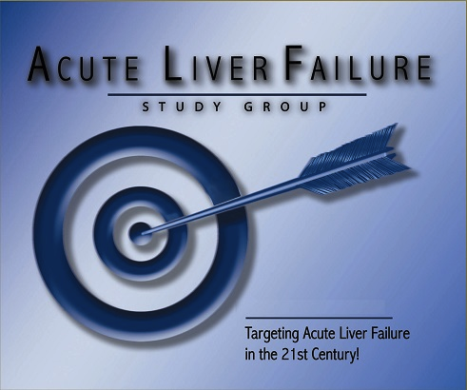
ALFSG and ALF
AIMS for this talk:
Review how we got started/how ALFSG was set up
Discuss clinical scenarios/etiologies
APAP: why is it a big deal
AIH/DILI/HBV
Clinical Trials
Prognosis
Role of transplantation
New initiatives:
  Causality/Pathology/OLT

Slide 4
Acute Liver Failure: A ‘Super Orphan’ Disease
Fulminant Hepatic Failure
Most severe form of liver injury but rare, 2,000/yr
Devastating: survival <10% in earlier era
Definition: INR ≥ 1.5, any grade enceph, acute illness
UNOS Status 1a
Fascinating
Frustrating
Hard to treat
Difficult to study
Notes:
4

Slide 5
Acute Liver Failure
CAUSE
Hep B
Budd-Chiari
DILI
Hep A
Autoimmune
HELLP
Indeterminate
Acetaminophen
HSV
Wilson Disease
Coma
Coagulopathy
Renal failure
EFFECT
Shock
Bleeding
Infection
Notes:
5

Slide 6
Acute Liver Failure
CAUSE
Loss of oval cells
Innate immunity
Apoptosis
Adaptive immunity
Necrosis
Genomics
Local factors
DIC
Cytokines
Cerebral edema
Toxic cellular debris
No regeneration
Poor synthetic fxn
EFFECT
Poor toxin clearance
Increased infection risk
Notes:
6

Slide 7
Acute Liver Failure Study Group (ALFSG):
Rationale: Network to study a rare disease
Began in 1998, currently 12 adult sites
2,600+ ALF cases in adult, ~1,100 in PALF registry
Plus 780 ALI, defined as: INR >2.0/no enceph
Three directions:
  Prospective clinical data, sera, urine, plasma, DNA, Numerous ancillary studies in progress: 105 ms.!
  Therapy trials: NAC, STOP-ALF; MBT and ROTEM
ALFSG funding: NIDDK U-01 through 2020

Slide 8
1998: where were you/we then?
Bill Clinton affair w/ Monica Lewinsky, House sends impeachment findings to Senate
Winter Olympics in Nagano, Japan
‘Titanic’ wins 11 Oscars
Good Friday agreement signed in Belfast
First Euro coins were minted
Space shuttle Endeavor lifts off to equip the International Space Station
January 1998: first patient enrolled at Mayo Rochester Jan 2nd
Notes:
8

Slide 9
The Journey through the Years

Slide 10
ALFSG Accomplishments: 1998-2010
Development of the registry: paper CRFs
Sample collection and storage: move to NIDDK storage 2007
Descriptive papers on most etiologies: APAP 2005
Developed ALI category 2007
NAC trial 1998—2006, published in Gastro 2009
Acetaminophen adducts 2006 and following
Submission of Public Use Dataset for 1998-2010
Notes:
10

Slide 11
ALFSG Accomplishments: 2010-2019
Conversion to electronic CRF, DCC at MUSC 2010
Fewer sites 2010-present
Pathogenesis Conference 2011 published in Gastro
STOP-ALF 2012-2016 published in Hepatology
Point of care adduct testing: 2014-present
~105 papers, 57 involving bio-samples
2015-7: 4 keystone papers: Overview, LT, Prognosis, ALI
Two Apps: Checklist and ALFSG Prognostic Index
Notes:
11

Slide 12
Etiology of Acute Liver Failure in the USA
Adult Registry (n = 2,614) uncorrected for Causality data
46%
ALF Study Group, March 2019
11%
12%

Slide 13
Comparison of Different ALF Etiology Groups
N = 2614
 | APAP N=1195 | Drug n=283 | Indeterminate n=304 | HepA / HepB n=39 / 188 | All Others N=605
Age (median) | 37 | 47 | 40.5 | 50 / 45 | 46
Sex (% F) | 75 | 67.1 | 61.2 | 45 / 46 | 69.4
Jaundice to coma (Days) | 1 | 12 | 10 | 4 / 8 | 7
Coma ≥3 (%) | 53.7 | 35.9 | 46.3 | 53.9 / 50.8 | 41.5
ALT (median IU) | 3780 | 654 | 864 | 2229 / 1410 | 810
Bili (median) | 4.3 | 19.6 | 19.9 | 12.0 / 19.2 | 11.7
Tx (%) | 8.6 | 38.5 | 42.3 | 33.3 / 39.9 | 27.4
Spontaneous Survival (%) | 64.6 | 24.7 | 23.4 | 51.3 / 18.6 | 31.9
Overall Survival (%) | 71.8 | 58.6 | 61.5 | 76.9 / 52.6 | 55.5

Slide 14
Clinical Feature | Etiology of ALF N = 2614
 | Paracetamol N=1195 | Ischemia N=181 | DILI N=283 | AI-ALF N=173 | HBV N=188 | HAV N=39 | Pregnant N=27 | All Others N=528
Age (median years) | 37 | 53 | 47 | 46 | 45 | 50 | 31 | 40
Gender (% Female) | 75 | 58 | 67 | 81 | 45 | 44 | 100 | 64
Jaundice-coma (median days) | 1 | 2 | 12 | 16 | 8 | 4 | 7 | 7
HE Grade ≥3 (%) | 54 | 56 | 36 | 27 | 51 | 54 | 54 | 44
ALT (median IU/L) | 3780 | 2311 | 654 | 404 | 1410 | 2229 | 43 | 758
Bilirubin (median mg/dl) | 4.3 | 3.8 | 19.6 | 22.8 | 19.2 | 12.0 | 9.0 | 16.2
Transplanted* (%) | 9 | 2 | 39 | 57 | 40 | 33 | 4 | 36
Transplant-free survival* (%) | 65 | 57 | 24 | 14 | 19 | 51 | 78 | 22
Overall Survival* (%) | 72 | 58 | 58 | 63 | 53 | 77 | 82 | 55

Slide 15
Acetaminophen (Paracetamol) Hepatotoxicity
Popular (mild) pain reliever
Dose-related toxin for all mammalian species
Dwarfs all other forms of drug-related liver injury
Largest selling OTC product/largest Rx generic
Multi-billion dollar product/well-protected brand
>100,000 calls annually to poison control centers
400+ deaths annually in the US, similar in EU
Iconic model for studying liver injury
Keeps basic scientists and clinicians employed!

Slide 16
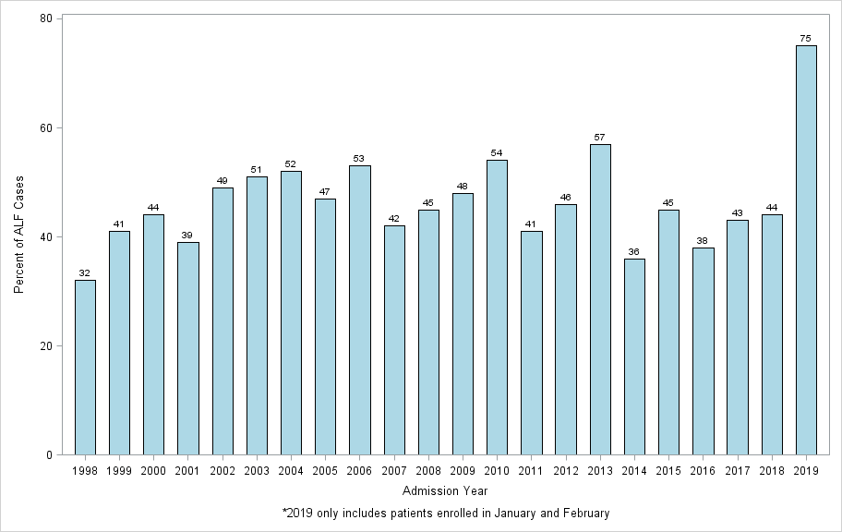
Acetaminophen cases as % of all ALF per year
Notes:
16

Slide 17
Parkland Hospital study of APAP overdoses
Suicidal: n=50 Unintentional: n=21
Suicide admitted
Single time point
No cause of pain
Early presentation
20% ALT > 1,000
1 ALF/death in 50 (2%)
Suicide denied
Several days’ use
Reason for pain
Late presentation
Virtually all high ALT
8 ALF; 6 (29%) died
Schiødt FV et al., NEJM 1997:337:1112-17
Only 9 of 71 had ALF, nearly all were unintentional

Slide 18
‘Suicidal’ vs.‘Accidental’ APAP cases
N=606 Intentional Unintentional p-value
(56=unk) (n=251) (n=296)
Female (%) 77 71 NS
Age 35 39 < 0.001
ACM dose(g) 38/38 47/7.5 NS
Coma (% >3) 39 55 < 0.026
ALT (IU/L) 6053 4207 < 0.0001
Alcohol use/abuse (%) 50/18 50/17 NS
Antidepress’t (%) 39 34 NS
History of depression (%) 45 24 < 0.001
Opioid cpd (%) 18 63 < 0.001
Multiple preps (%) 5 38 < 0.001
Spont surv (%) 70 65 NS

Slide 19
Acetaminophen (APAP-Cys) adducts assay
HPLC-EC detects APAP-cysteine residues (smoking gun)
Highly sensitive and specific
Excellent correlation with AST
Remains positive up to 9 days after ingestion
Present in 20% of indeterminate cases, peds and adults
Davern TJ, et al. Gastroenterology 2006;130:687-94
James LP, et al. Pediatrics 2006;118:e676-681.

Slide 20
Indeterminate with adducts N=7 19%
Of 36 indeterminates, 7 (19%) demonstrated adducts
Known APAP
Acetaminophen-CYS (umol/L)/mg protein
Indeterminate
without adducts
N=29
Other ALF
APAP
No tox
Patient Group
Davern TJ, James LP, et al. Gastroenterology 2006;130:687-94

Slide 21
Examination of APAP adducts in ALF
Indeterminate
Grp 1 (APAP) Grp 2 (Adduct pos) Grp 3 (Adduct neg) p value
N=188 N=20 N=90
Age 37 33 39 NS
Gender % fem 75 80 48 < 0/001
ALT (IU/L) 4,025 5,156 811 < 0.001
Adduct levels 11.1 9.2 0 < 0.001
Bilirubin (mg/dl) 4.1 5.1 24.3 < 0.001
NAC Rec’d (%) 94 40 18 < 0.001
Spont survival 64 55 21 < 0.001
Khandelwal N et al Hepatology 2011;53:567-76

Slide 22
Most frequent DILI agents in adults
ALFSG
N=137
DILIN
N=899
Antibiotics 408
Amox/Clavulanate 0 91 INH (w/wo rif/pyraz) 25 28
Nitrofurantoin 11 42
Sulfa (TMP/SMX, sulfasalazine 12 31
Minocycline 6 28
Cefazolin 0 20
Others 13 115
Herbal and Dietary Supplements 14 145
CNS 18 82

Slide 29
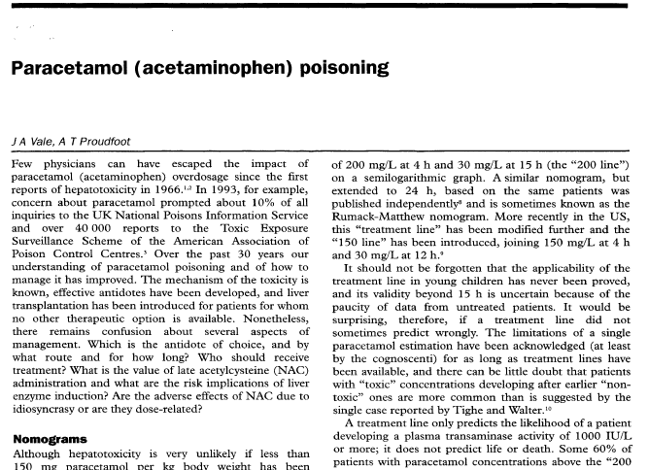
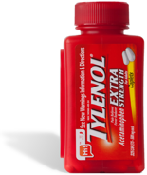
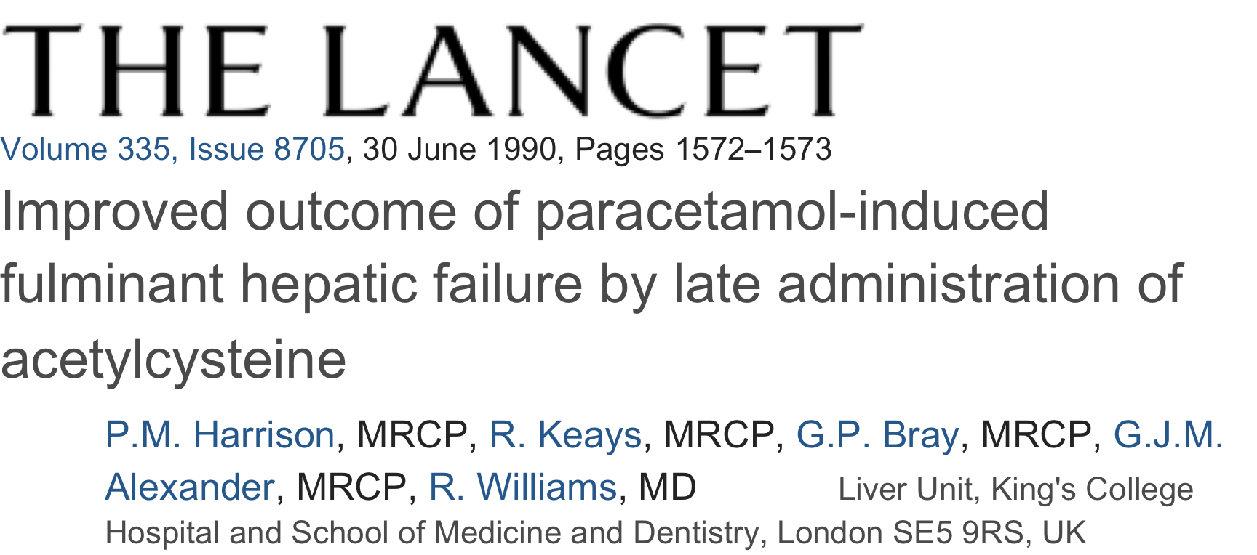
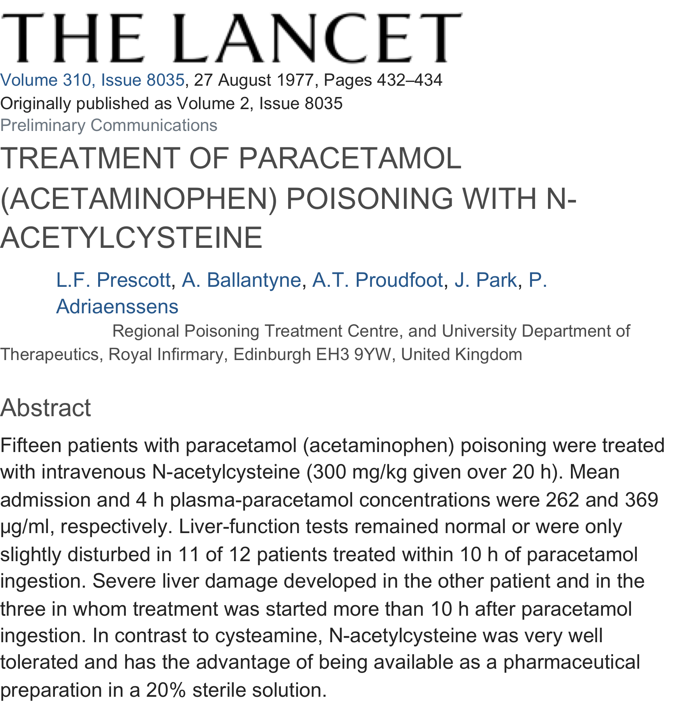
TREATMENT
1977
NAC is the accepted standard of care antidote worldwide—should be used even when uncertain
1995
1990

Slide 30
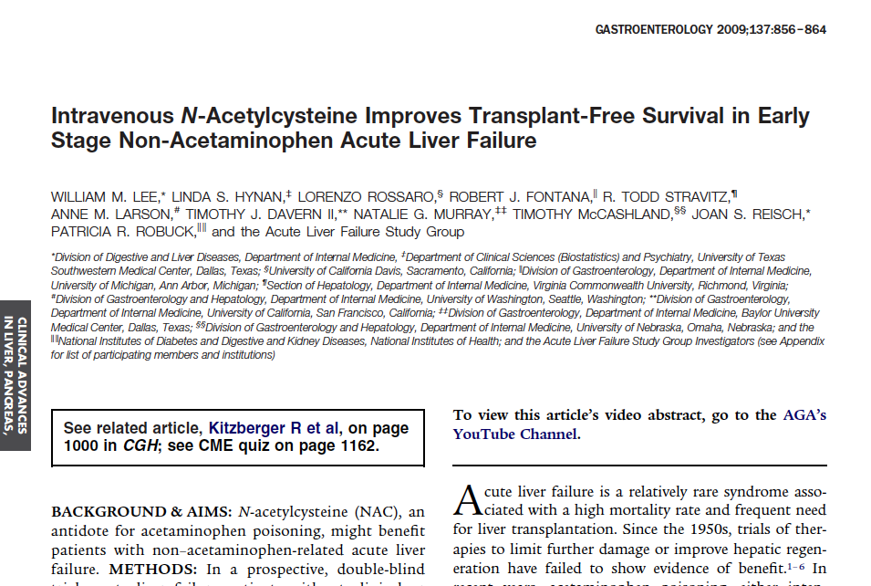

Slide 31
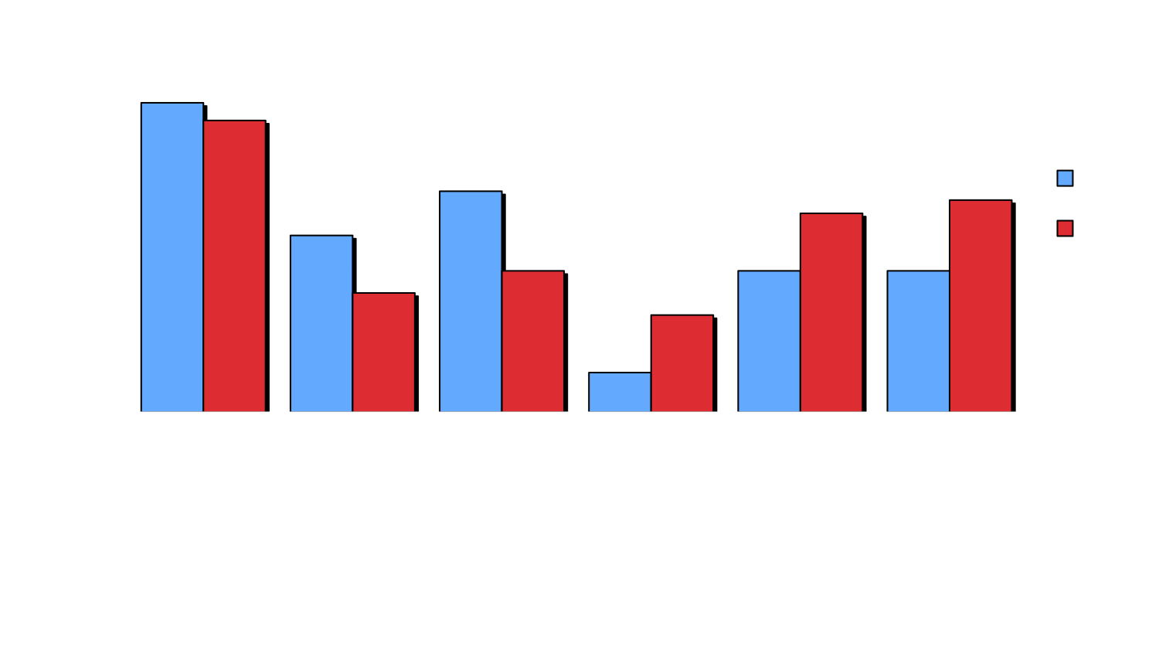
Primary/secondary outcomes in the NAC trial
p< 0.28
*p< 0.01
*p< 0.035
Percent
p< 0.09
*p< 0.04
p< 0.09
Gastro 2009
The most impressive difference was in transplant free survival in coma grades I-II. * = statistically significant

Slide 32
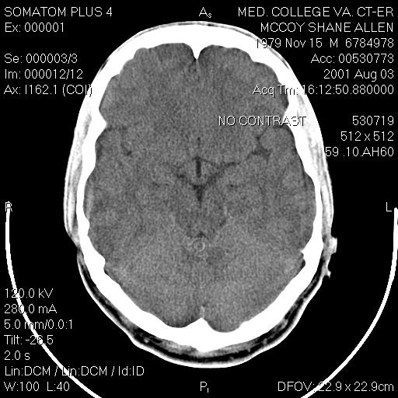
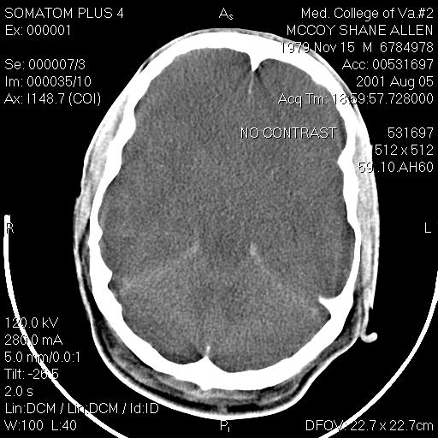
32 year-old male with ALF of indeterminate etiology
Admission head CT
48 h after admission

Slide 33
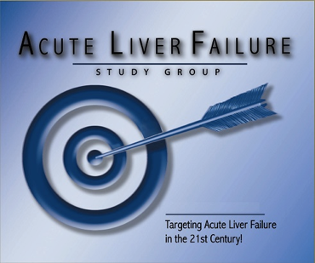
Ornithine Phenyl Acetate (OPA): STOP-ALF Trial
Lower ammonia to manage cerebral edema
Ammonia is the putative cause for cerebral edema
OPA traps ammonia and allows renal excretion
Could be used prophylactically or as treatment
IV, few side effects, might work in cirrhosis also
ALFSG studied OPA in ALF/ALI group
Study completed in 2016.
Stravitz et al Hepatology 2018;67:1003

Slide 34
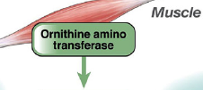
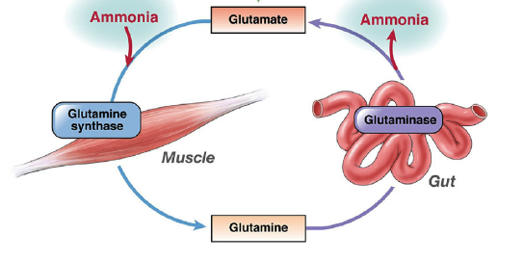
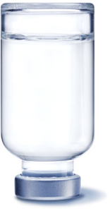

OCR-002 Uses Physiological Pathways to Eliminate Nitrogen
ornithine
OCR-002
phenylacetate
Phenacetyl-CoA : Gln acyltransferase
PAGN
Lee WM, Jalan RV. Gastroenterology 2009

Slide 35
Safety and Tolerability of OPA for ALF
Results of STOP-ALF Phase IIa Trial
Study completed in 47 patients, no safety signals
OPA likely under-dosed in the early phase
Mild nausea/HA only apparent symptoms
20 gm/day dose associated with improved NH₃
Parallel trial has been completed for management of HE in patients with cirrhosis: STOP-HE
Stravitz et al Hepatology 2018;67:1003
Notes:
35

Slide 36
Percent Change in NH₃ Over Time

Slide 37
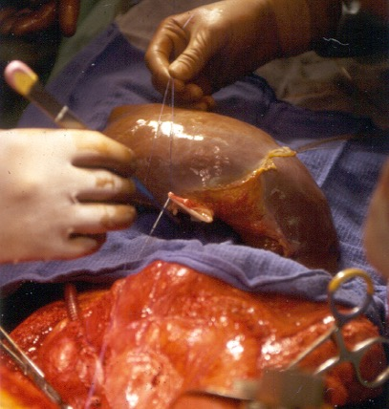

Slide 38
Transplant Outcomes in ALF: 1998-2013
Overall: 1696, of whom 614 (36%) listed
APAP: n=173 (22%) non-APAP: n=441 (56%)
Sicker at listing
36% received LT
Time to death: 2 days
54% of deaths w/in 24 hours of listing
Less sick
74% received LT
Time to death 4.5 days
Median time to LT: 4 days
Non-APAP patients more likely to survive to 4 days to receive a graft.
Reddy KR et al. Liver Transplant 2016;164;724.

Slide 39
Reddy et al. Liver Transplant 2016

Slide 40
Reddy et al. Liver Transplant 2016

Slide 41
KR Reddy et al
Determinants of Outcome Among Patients with Acute Liver Failure Listed for Liver Transplantation in the US
Conclusions
Decisions need to be made extremely rapidly in APAP cases
Those with slower disease evolution more likely to receive a graft
Those receiving a liver, resemble those that recovered more than they resemble those that died
It is not clear that everyone that received a liver needed it
Reddy et al. Liver Transplant 2016;164:724.
Notes:
41

Slide 42
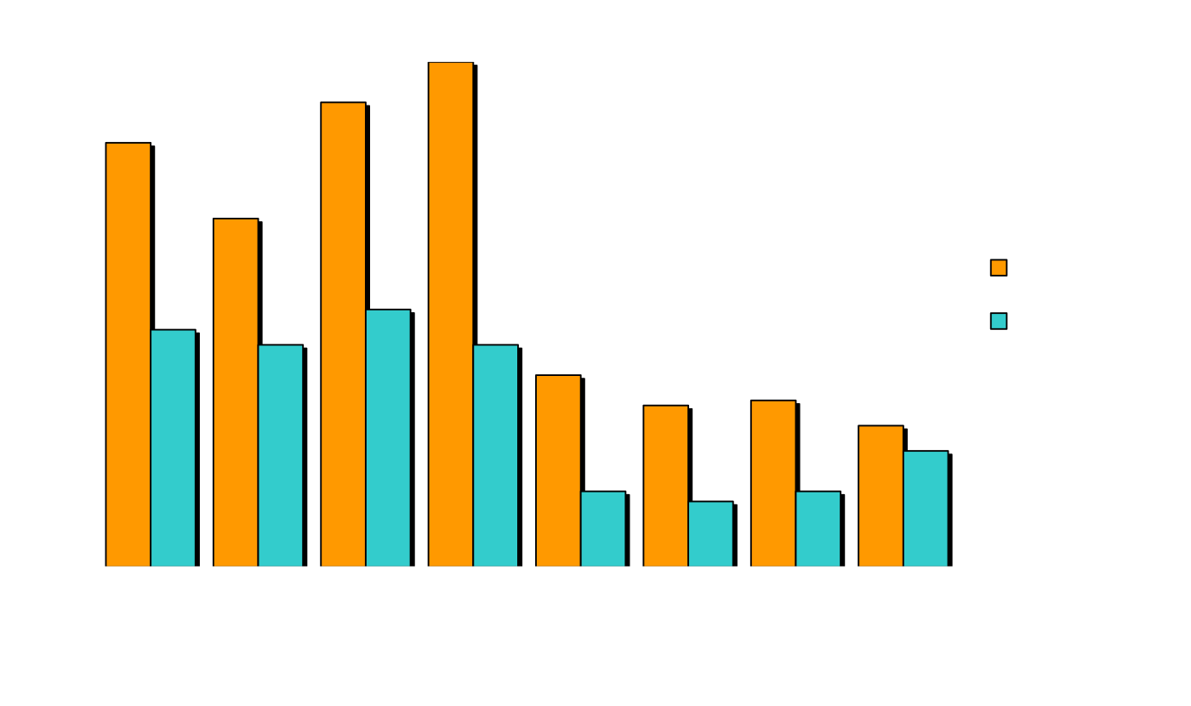
Transplant-free survival by etiology and coma grade
55%
68%
65%
56%
Percent
26%
27%
26%
25%
Coma grade I-II patients had ~50% better survival than III-IV

Slide 43
Prognosis in ALF: Etiology is a Main Determinant
Transplant free survival rates differ greatly
Good prognosis:
APAP 66%
Ischemia 66%
Pregnancy 55%
Hepatitis A 56%
Bad prognosis:
Drugs 27%
Indeterminate 25%
Autoimmune 26%
Hepatitis B 26%
Wilson Disease 0%
(Age is NOT an important determinant)*
*Schiødt FV, et al., Liver Transplant 2009
Notes:
43

Slide 44
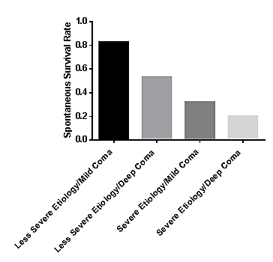
ALFSG Prognostic Score
Significance of Etiology and Coma Grade

Slide 45
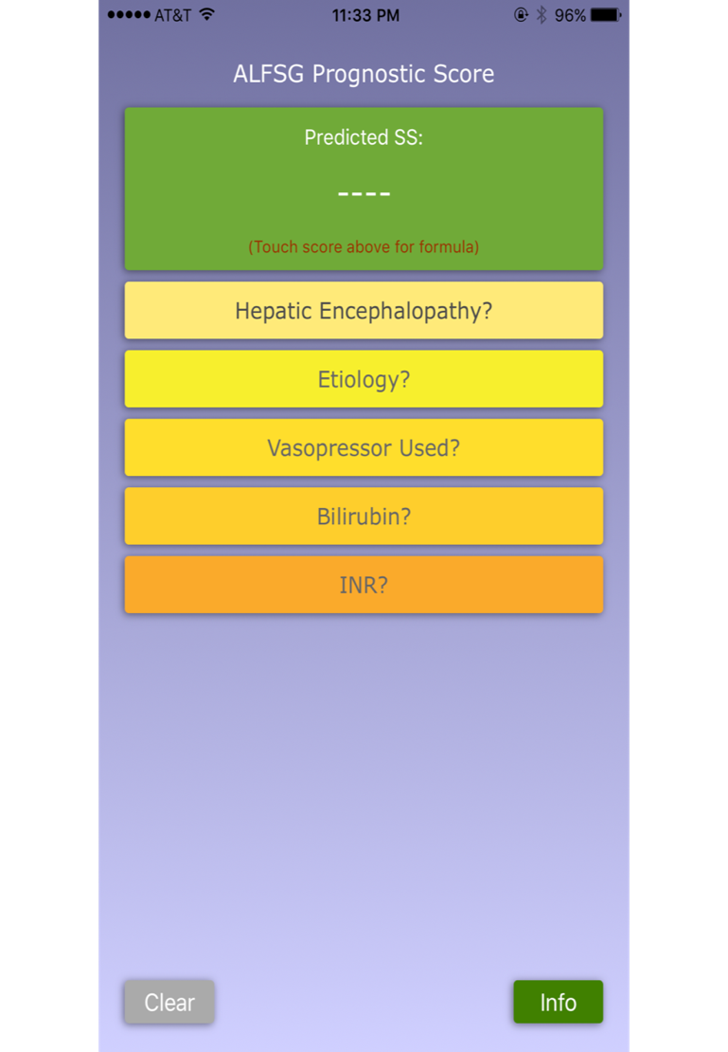
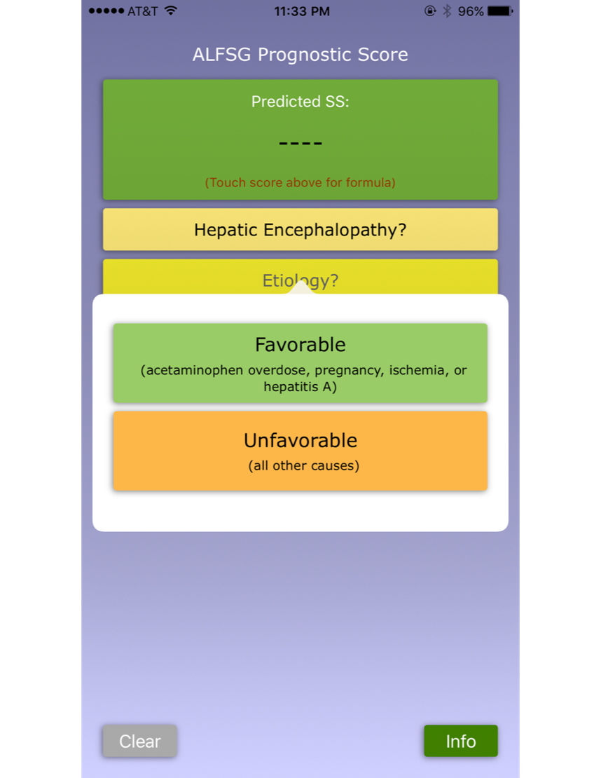

Slide 46
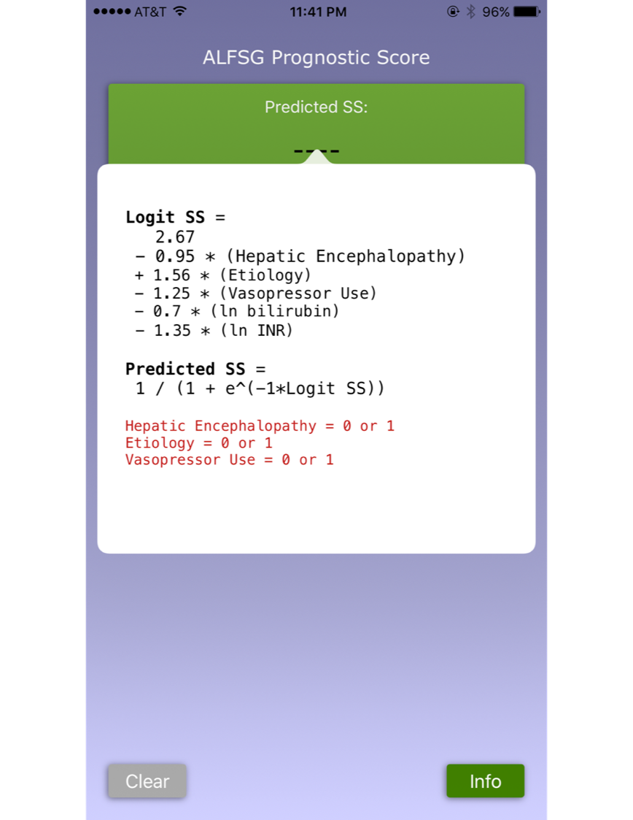
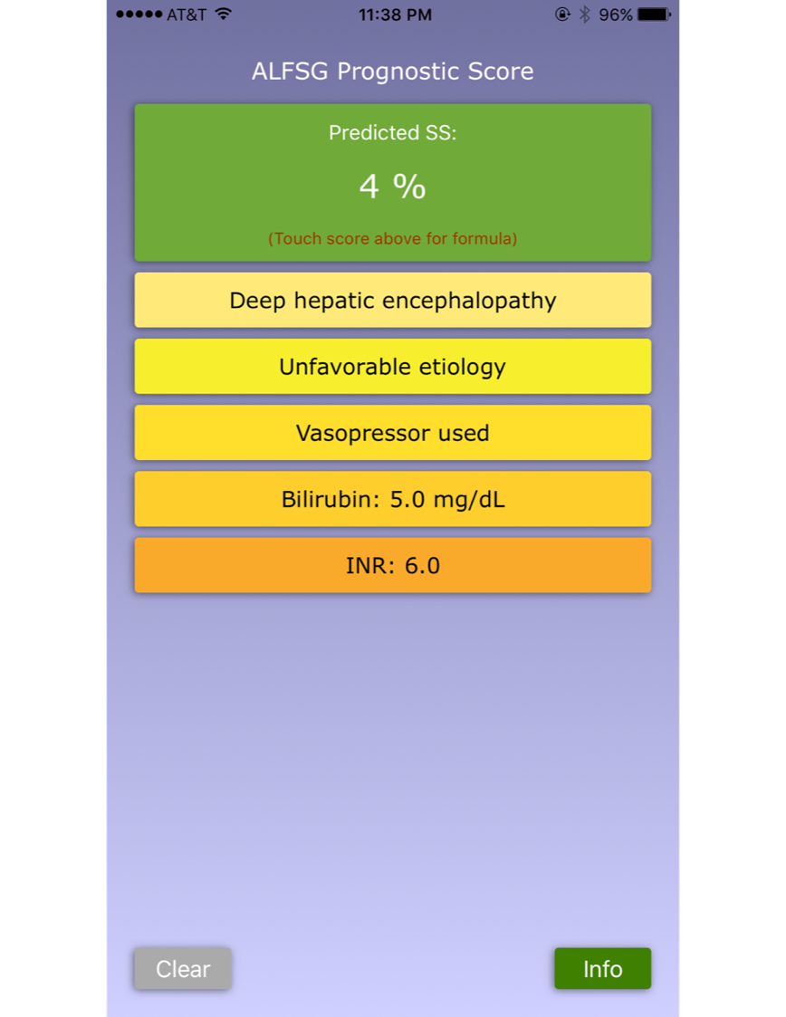
ALFSG website
acuteliverfailure.org
Koch et al CGH 2016;14:1199,

Slide 47
Outcomes in Adults with Acute Liver Failure from 1998-2013:
An Observational Cohort Study
Have changes in management/outcomes occurred?
2070 patients in 16 yrs, with 21 day outcomes known
No differences in etiologies or disease severity, referral patterns or time to referral
Results: decline in:
  Listing, deaths, transplantation
  Use of vasopressors, ventilation, blood products
  Overall and transplant-free survival improved.
Reuben A et al: Ann Intern Med April 2016
Notes:
47

Slide 48
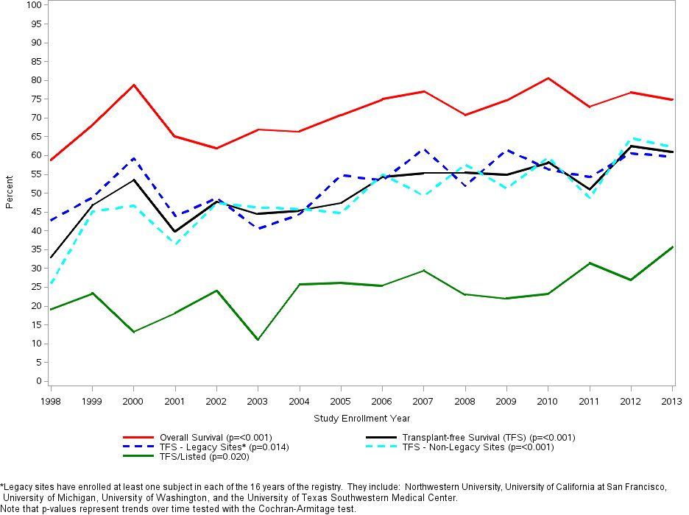
Overall and transplant-free survival over time: 1998-2013
Reuben A et al: Ann Intern Med April 2016

Slide 49
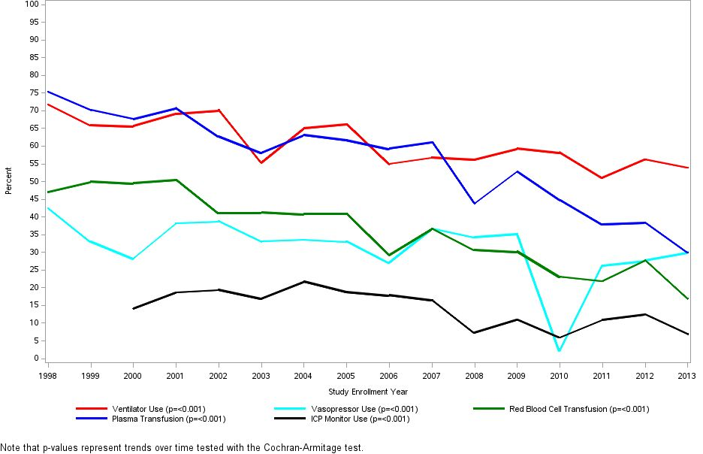
Treatment modalities over time
Reuben et al., Ann Intern Med 2016

Slide 50
Acute Liver Failure: A ‘Super Orphan’ Disease
Overall lessons
Act quickly, acute patients evolve over hours
Etiology is tied to prognosis and treatment options/antidotes
Consider the transplant option early
Good intensive care with attention to:
  CNS: Neuro checks, no sedation, watch for deterioration
  Renal: Consider CRRT
  Pulmonary: intubate for Gr III-IV coma
  Infection: frequent cultures, no empiric antibiotics
  May need volume but not too much, pressor support
  Don’t correct coagulopathy, little FFP needed
Notes:
50

Slide 51
Acute Liver Failure Study Group: Current Projects
APAP adducts: refining a point-of-care assay
Causality: Re-adjudicating all cases using expert opinion
Autoimmune study: 400+ sera to KCH for autoAb tests
Transplant initiative: Combining SRTR and ALFSG data
ROTEM: 200 patients studied, analyzing the results
Methacetin breath test: prognostic tool
Pathology: Developing an explant registry: 300+ explants
  Describing the histopathology of ALF
Temporal Trends: Could ALF be disappearing?
Notes:
51

Slide 52
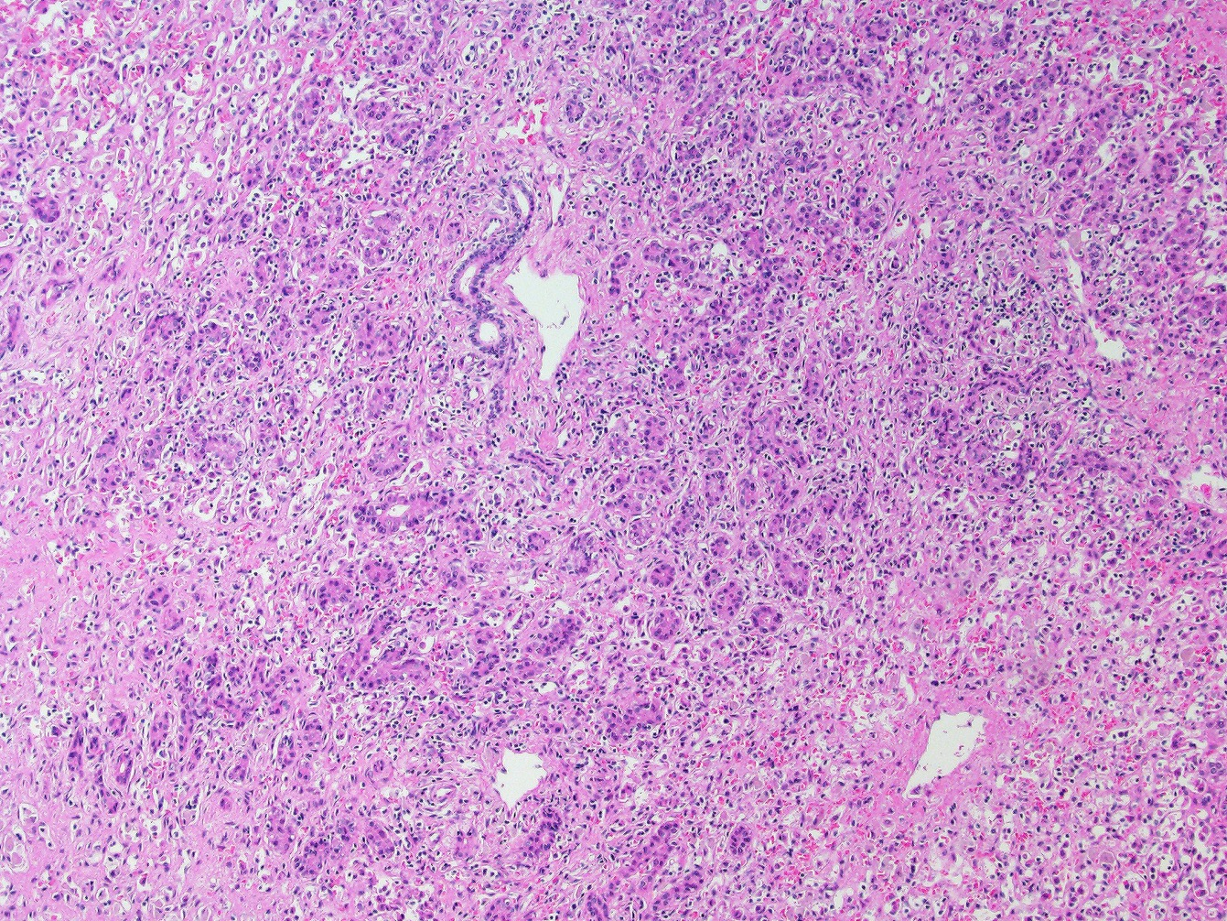

Slide 53
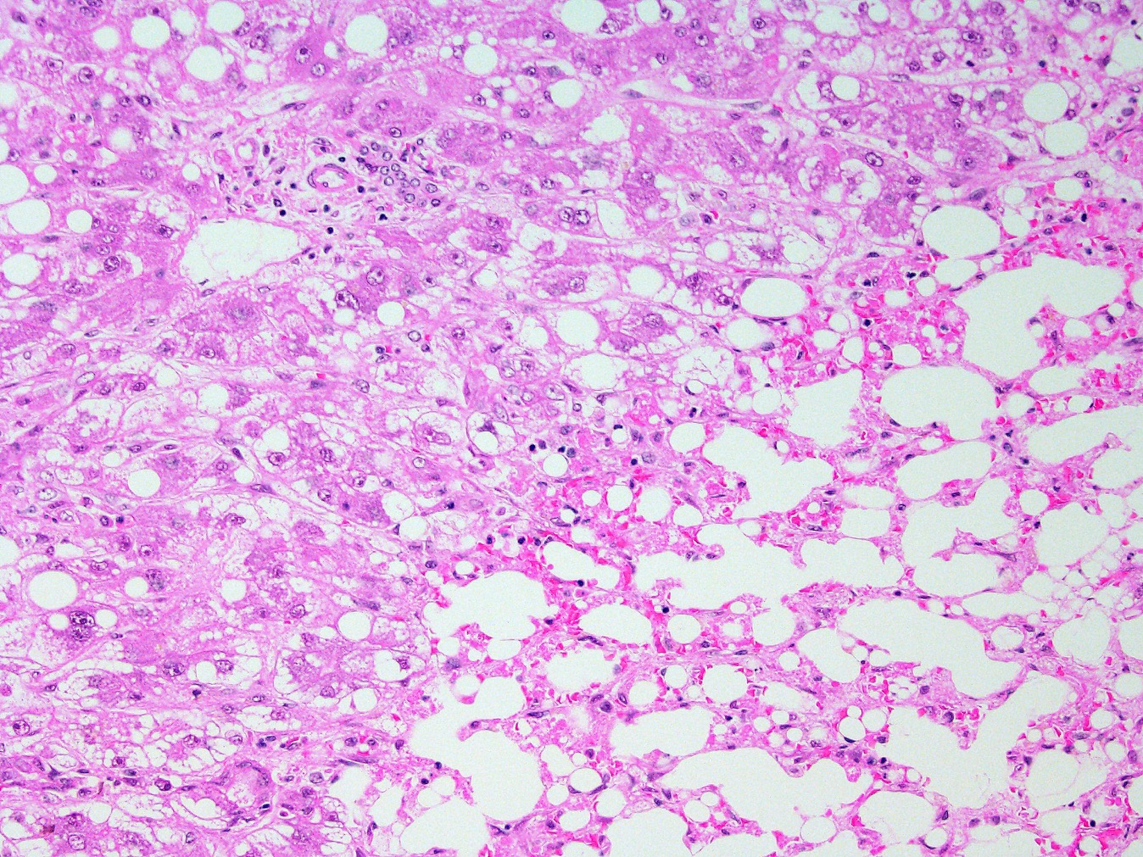

Slide 54
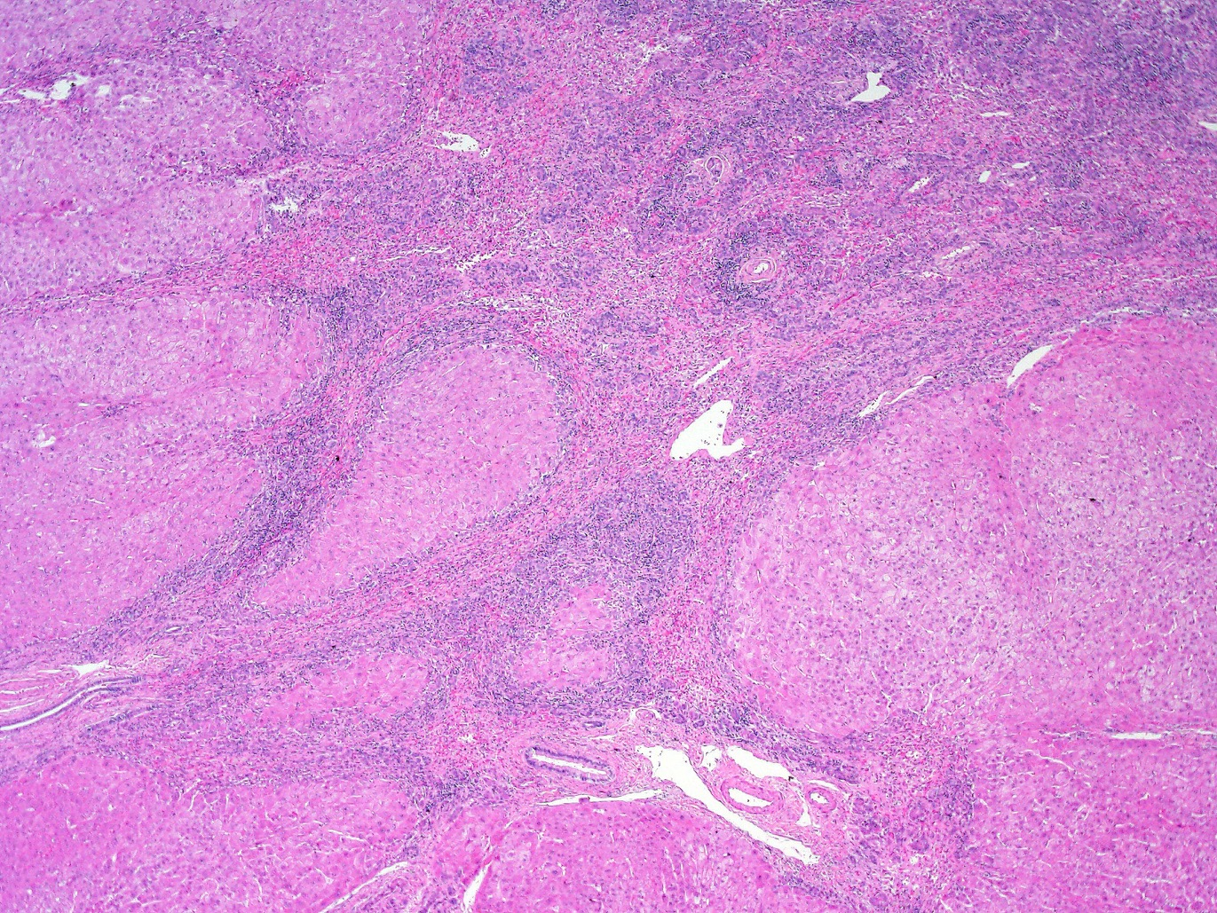

Slide 55
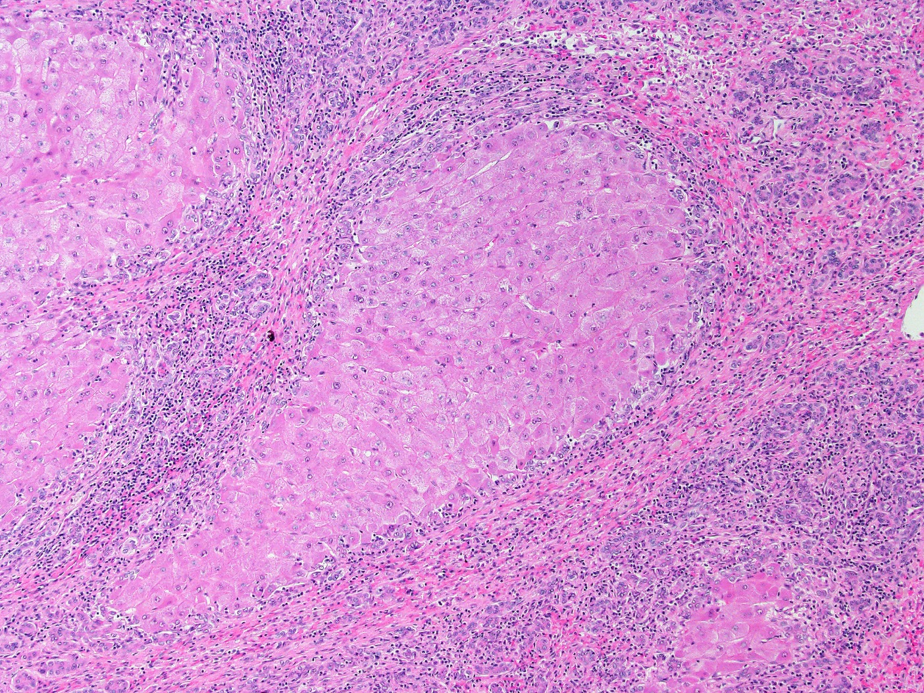

Slide 56
Clinical Case
23 yr old new arrival from Guinea, West Africa
Two week illness with abdominal pain/N/V
Healthy male, deeply jaundiced, alert and awake
Bili 40.2, AST/ALT >4000/>4000, INR 4.2, Cr 0.7
Notes:
56

Slide 57
Acute Liver Failure: A ‘Super Orphan’ Disease
Lessons Learned
There are two patterns of injury: short and long
Main etiologies: APAP/shock vs. AIH/HBV/DILI
Overall outcomes are improving, txplt less needed
NAC for most patients, but this not FDA approved
Extremely hard to conduct clinical trials in this space
ALF is best studied with a multi-center network, but may be disappearing.
Acute Liver Failure: Science and Practice, March 30-31, 2020
Website: acuteliverfailure.org for more information on performing ancillary studies
Notes:
57

Slide 58
Adult Study Sites in the ALFSG 2019
UT Southwestern Lee/Tujios/Rule/Rowan
U Washington Liou/Kim
UCSF Hameed/
Northwestern University Ganger/Gottstein
Michigan Fontana/
Univ Alabama Birmingham McGuire/Williams
VCU Stravitz/Taylor
MUSC Charleston Koch/Crolley
Yale University Schilsky/Stavris
University of Kansas Olson/Taylor
The Ohio State University Hanje/Hayes
University of Alberta Karvellas/Baig
UTSW: Admin Center
MUSC: Data Coordinating Center
Valerie Durkalski, PhD
Caitlyn Meinzer, PhD
Evan Tomaszek
Kristen Clasen
Michelle Gottfried
Nahid Attar
Rehana Mohammed
Ambar Hill
Debra Rowan
Jody Rule, PhD

Slide 59
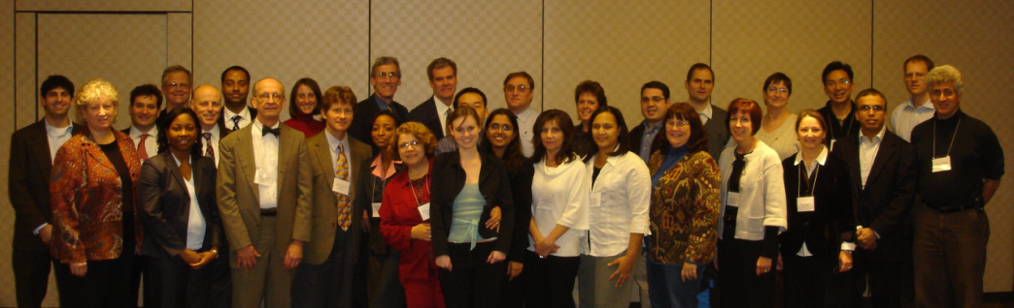

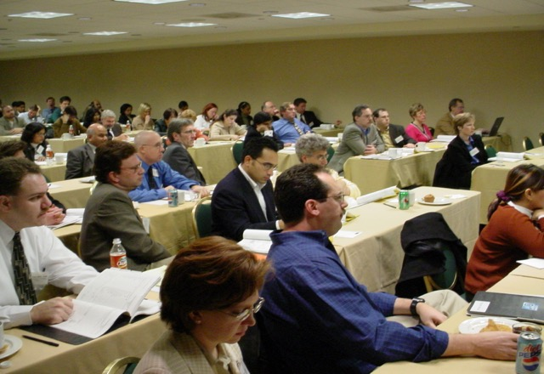
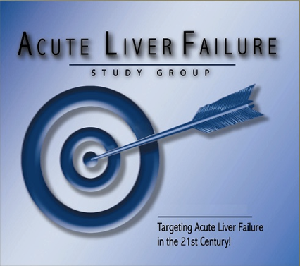


Slide 60

acuteliverfailure.org

